Slide 1
Project Vivifi
CIS440 10:30am Section
Justin Choi
Alex Lepak
Nick Muscara
Jessa Short
Christian Valenty
Jason Weeks

Slide 2
Company Background
Vivifi is a recent start-up initiative run through three recent ASU graduates to link musicians to local events or event planners. They envision this as an opportunity to be ‘hip’ and ‘trendy’ with a primary focus on easy usability for their target audiences.

Slide 3
Project Scope
Vivifi has a defined scope that is open for public but gear towards an audience
The target audience that this project affects include:
Musicians - specifically both solo and ensemble
Local event coordinators and/or people looking to have musicians staffed at their events or engagements

Slide 4
Capstone Primary Deliverables
Fully functioning website
4-prong detail: ensembles, search form, custom form, contact
Search engine (auto-populate response) feature
Backend database storage and development

Slide 5
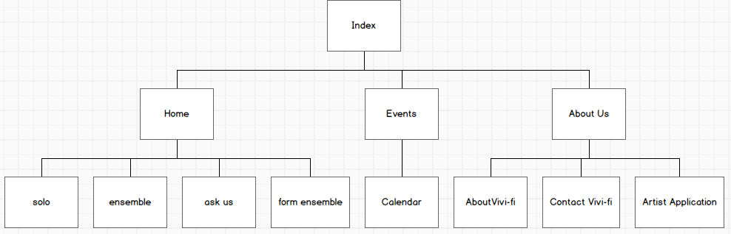
Site Map Mock-up:
***All Mockups made from the software @ https://balsamiq.com/ and are only suggestions / ideas and are subject to change. Not everything planned will be implemented in final project.

Slide 6
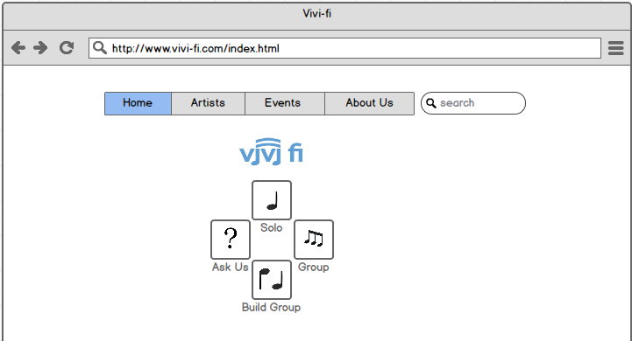
Wireframe Mock-up: Index Page
Primary Action(s):
Displays company logo
Houses interactive navigation bar
Houses search menu

Slide 7
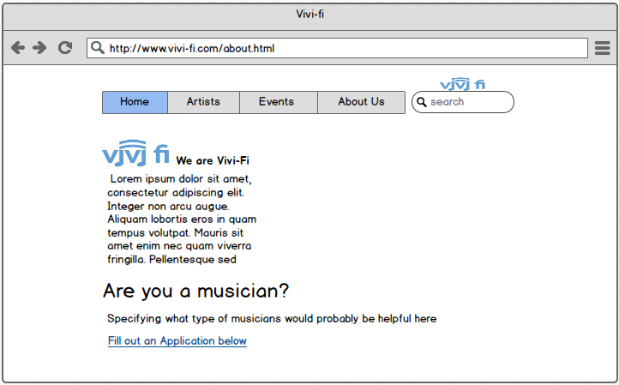
Wireframe Mock-up: About Us
Primary Action(s):
Displays company background
Houses forms for musicians to fill out

Slide 8
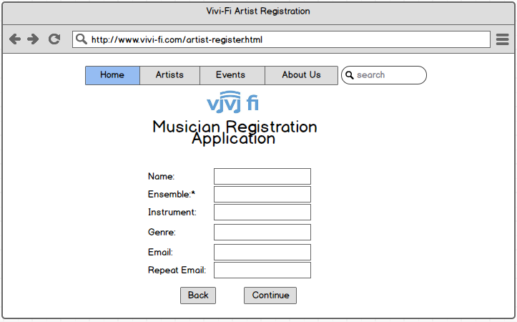
Wireframe Mock-up: Artist Registration
Primary Action(s):
Houses functional form for musicians to fill out

Slide 9
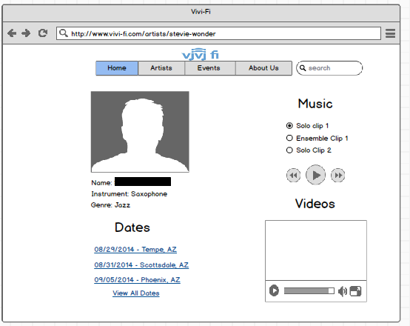
Wireframe Mock-up: Musician Page
Primary Public Action(s):
Stores video and music clips
Dates is an optional feature
Houses button to request artist
***All personal contact information is not public

Slide 10
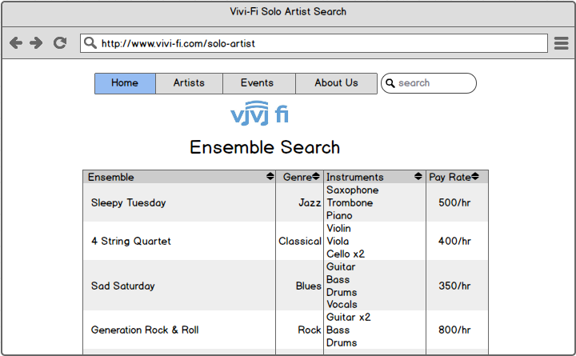
Wireframe Mock-up: Ensemble Search
Primary Public Action(s):
Houses search feature for ensemble
Ability to organize search returns based on: ensemble, genre, instruments, and pay rate

Slide 11
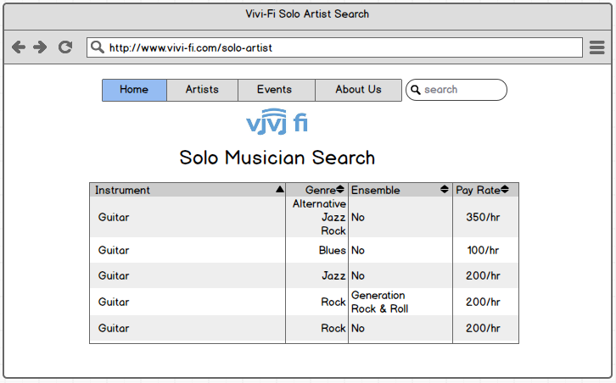
Wireframe Mock-up: Solo Artist Search
Primary Public Action(s):
Houses search feature for solo artists
Ability to organize search returns based on: ensemble, genre, instruments, and pay rate
‘Clickability’ to artist page (redirects)

Slide 12
Project Management
Team will be taking a scrum-based approach:
Daily check-in ‘sprints’ via online form
Weekly meetings on Monday evenings
Scrum celebrations will take place on each designated demo day
Summary celebration for client 48 hours after demo release

